Slide 1
Data Science Process
Credit One

Slide 2
Goal or Business Question:
Problem:
Data Collection
Credit One data has been downloaded.
Evaluate Data
Data has been analyzed and preprocessed to be used (BILL 1,3, and 5 have been dropped).
Prepare Data
Column names have been changed to be used and for accuracy of results.
Unnecessary columns removed
Duplicates removed
Revenue and customer loss for clients and, eventually, loss of clients for Credit One
Investigative Questions:
How do you ensure that customers can/will pay their loans? Can we do this?
Increase in customer default rates - This is bad for Credit One since we approve the customers for loans in the first place.

Slide 3
Insights about the data
Which techniques might I apply to build the model? Rainforest Classifier
Evaluate Model and Insights
Is the model accurate enough to meet the stakeholders’ needs? 0.8 score obtained
How do you rank your findings in terms of quantified impact on the business? Our date cannot answer any specific question.
Recommendations
How can you most effectively present the results of your analysis to your stakeholders (in terms they can understand and in alignment with information they’ll value)?
Deploy and maintain the model
How often should we revise the model?
What patterns do you see in the data?
Model data
The independent variables, AGE, PAY_0, PAY_2, PAY_3, PAY_4, PAY_5, and PAY_6, are correlated (affect each other) to the dependent variable “DEFAULT”.

Slide 4

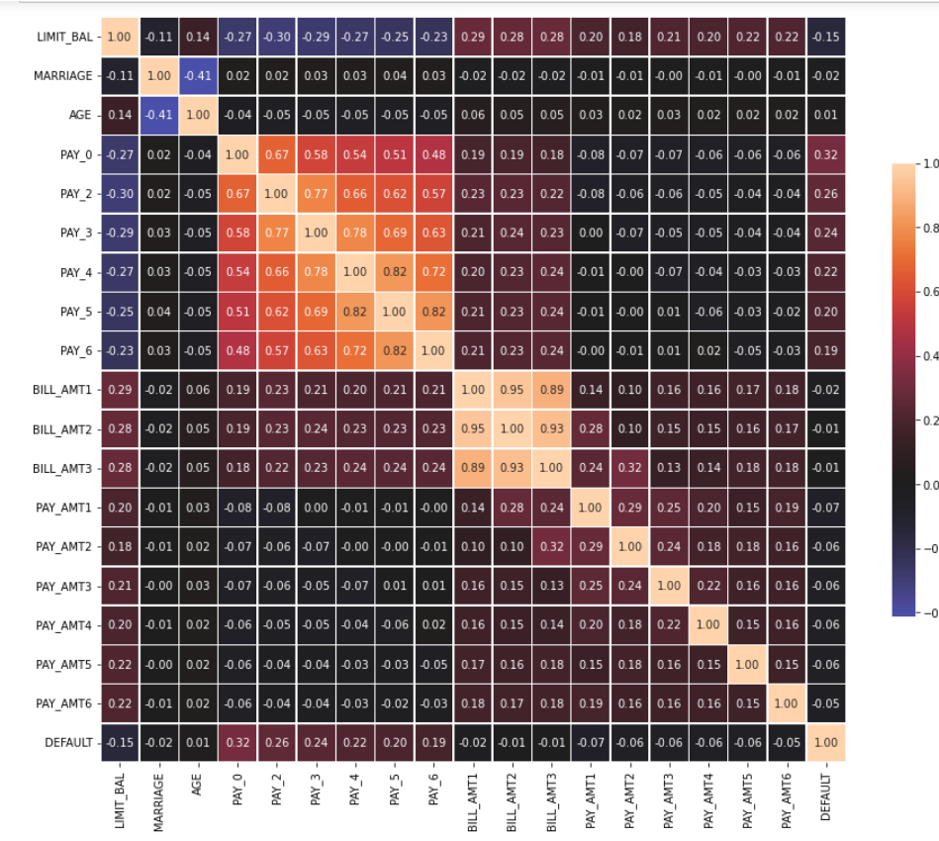


Correlation Matrix

Slide 5


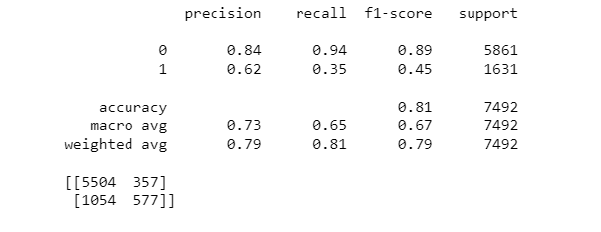

Accuracy

